Slide 1
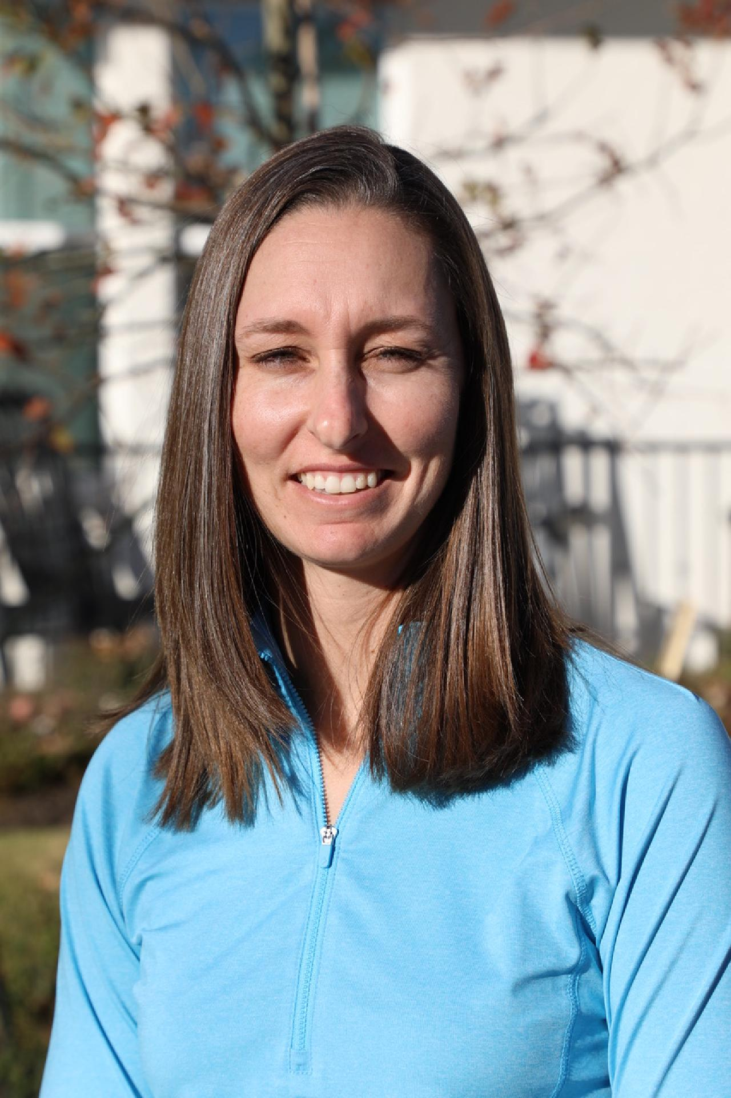
PM
Ashley Knoll Golf Academy
Summer Camp information
MONDAY
WEDNESDAY
THURSDAY
A
2:30-3:30 PM
Summer Camp schedule
Camps will be Tuesday-Thursday 8:00AM-11:00AM
B
3:30-4:30 PM
June Ages 5 + | July Ages 5+ | August Ages 5+
June 4-6 | July 16-18
June 11-13 | July 23-25
June 18-20
A
5:30-6:30 PM
Spring Semester
March 10th –May 5th
B
4:30-5:30 PM
MOST POPULAR
1 WEEK CAMP
2 WEEKS OF CAMP
3 WEEKS OF CAMP
Weekly 1-hour class
$285
$495
$720
$40
Select one camp from the dates listed above
Select two camps from the dates listed above
Select three camps from the dates listed above
Wednesday’s from 10:00-11:00
Dates:
June 12,19,26
July 10,17,24,30
August 7
For more information contact Ashley
ashleyknollgolf@gmail.com
832-567-3412
www.ashleyknollgolf.com
)

